Slide 1
Music Genre Classification
Presented by:
E028 – Karan Mehta
E035 – Dhruv Patel
E050 – Nihal Shetty
Presented to:
Prof. Priyanka Verma

Slide 2
Abstract
Music Genre classification is very important in today’s world due to rapid growth in music tracks, both online and offline. In order to have better access to these we need to index them accordingly. Automatic music genre classification is important to obtain music from a large collection. Most of the current music genre classification techniques uses machine learning techniques. In this report, we present a music dataset which includes ten different genres. A Deep Learning approach is used in order to train and classify the system. Here Convolution Neural Network is used for training and classification. Feature Extraction is the most crucial task for audio analysis. Mel Spectrogram is used as a feature vector for sound sample. The proposed system classifies music into various genres by extracting the feature vector. Our results show that the accuracy level of our system is around % and it will greatly improve and facilitate automatic classification of music genres..

Slide 3
Introduction
Music Genre Recognition is an important field of research in Music Information Retrieval (MIR).
A music genre is a conventional category that identifies some pieces of music as belonging to a shared tradition or set of conventions, i.e. it depicts the style of music.
Music Genre Recognition involves making use of features such as Spectrograms, Mel Spectrogram, MFCC’s for predicting the genre of music.
Why classify music into genres?
Companies nowadays use music classification, either to be able to place recommendations to their customers (such as Spotify, Soundcloud) or simply as a product (for example, Shazam). Determining music genres is the first step in that direction.

Slide 4
Problem Definition
This project aims to predict the genre of an audio sample from a set of 10 defined classes by implementing a Convolutional Neural Network Model over the Mel Spectrograms generated from the GTZAN Dataset.

Slide 5
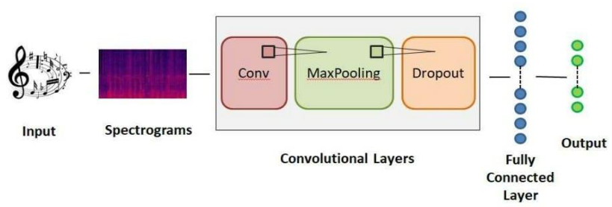
Working of CNN
Our model helps classify music under the genres of the GTZAN dataset. Convolutional Neural Network (CNN) is a deep learning model which delivers great performance with images and basically saves sizeable number of efforts and time.

Slide 6
Results
Dataset Size | Train/Test Splitting | Training Accuracy(%) | Validation Accuracy(%)
1000 | 90/10 | 76.33 | 31
1000 | 80/20 | 100 | 69.5
10000 | 90/10 | 99.87 | 84

Slide 7
Conclusion
The models we created are for Music genre classification. The exponential growth within digital industry causes an urgent need for effective genre classification for users as well as content provider. The model we created is robust and cost effective because open-source tools like Python, Jupyter can be used. And it is also easy to implement as it won’t need much higher specifications. In case of classification done by human beings there is a good chance of error because of the different nature of every individual. If we have some system which will categorize music into its respective genres automatically, we would save a large number of human efforts and time. CNN model used gives better accuracies., 99.87% training accuracy and 84% validation accuracy ,than conventional machine learning algorithms. Misclassification may occur in some cases due to complex audio tracks but overall CNN gives better accuracy.

